Slide 1
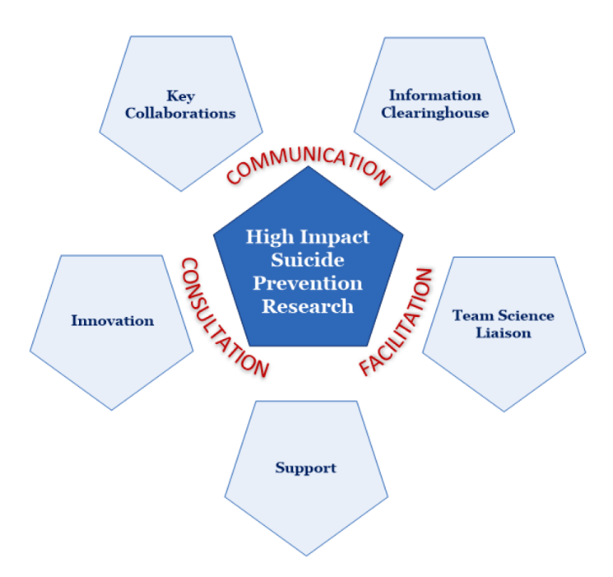
Suicide Prevention Research Impact NeTwork Review of Active Project Inventory (API)
May 23, 2022
Notes:
Introductions

Slide 2
Active Projects Inventory
SPRINT Goal #2: “Maintain an Active Projects Inventory (API) containing information about VHA and non-VHA health services and clinical SP research activities, VHA operations-funded SP demonstration projects, and up-to-date information on evidence underlying SP interventions.”
API Includes:
Active research and operations SP projects in Veteran (and military) populations
Projects with current funding during FY2023 as well as others with pending funding.
Projects required at least one aim/goal specifically focusing on suicide prevention
Databases and data sources:
ORD RAFT active project lists, distributed quarterly from Bob O’Brien
Review of VA funding announcements and lists posted on the VA ORD website
Dimensions (https://va.dimensions.ai/discover/publication)
NIH Reporter (https://reporter.nih.gov/)
Operations funding project lists (periodically) including OMHSP, VISN 2 CoE, and RM MIRECC
Word of mouth
Follow-up communications with investigators of funded projects

Slide 3
Data we collect and organize
Study aims, objectives, abstract
PI & Co-I name, location, and facility
Funding organization/line
Funding start and end date
Project funding/ID number
Database Source
Socioecological level
Public health approach
Study type
Keyword(s)
Study population

Slide 4
API Limitations/Challenges
Dependent on what is in RAFT
Missing newest funded projects
Missing some projects (e.g., CDAs; SWIFTS, etc.)
RAFT definitions of suicide prevention doesn’t always fit with ours
Hard to code and search for certain features of projects
Standardization would be helpful
Needs vary across users and over time
Manual effort is considerable
Manual RAFT pulls
Additional information needed from investigators
Coding dependent on investigators
Notes:
Aware VAIRRS will provide new data

Slide 5
VA Funded Projects FY2022/2023
VA Studies FY2022 N=126 94 unique investigators
Funding Source | Study Count
HSRD/QUERI | 38
CSRD | 27
Other OMHSP | 17
SPRINT Planning Awards | 8
Center of Excellence | 6
Office of Rural Health | 6
RRD (includes SPIRE) | 6
MIRECC | 5
Other | 5
BLRD | 3
Partnered ORD/Operations | 2
VISN-Funded | 2
SWIFTS | 1
Total | 126
VA Studies FY2023 N=152 114 unique investigators
Funding department | Study Count
HSRD/QUERI | 41
CSRD | 30
RRD (includes SPIRE) | 20
Other OMHSP | 17
Center of Excellence | 12
SPRINT planning award | 9
Other | 7
MIRECC | 6
BLRD | 4
ORH | 3
VISN-funded | 2
Partnered ORD/Operations | 1
Total | 152
FY2023 Project Funding Sources

Slide 6
VA-funded Projects by Study Type
Number of Projects by Study Type FY2021
Study Type | n | %
Other Observational | 36 | 28%
Observational-Cohort | 29 | 23%
Intervention-Pilot | 21 | 16%
Intervention-Trial | 18 | 14%
Implementation | 11 | 9%
Other | 9 | 7%
Bench/Animal Experimental | 4 | 3%
Total | 128
Number of Projects by Study Type FY2022
Study Type | n | %
Observational-Cohort | 39 | 31%
Other Observational | 29 | 23%
Intervention-Trial | 22 | 17%
Intervention-Pilot | 14 | 11%
Implementation | 9 | 7%
Other | 7 | 6%
Bench/Animal Experimental | 5 | 4%
NR | 1 | 1%
Total | 126
Number of Projects by Study Type FY2023
Study type | n | %
Observational-Cohort | 36 | 24%
Intervention-Trial | 29 | 19%
Other Observational | 24 | 16%
Intervention-Pilot | 23 | 15%
Other | 15 | 10%
NR | 11 | 7%
Implementation | 9 | 6%
Bench/Animal Experimental | 5 | 3%
Total | 152 | 100%
Notes:
Some increase in intervention trials over past few years
This also captures demonstration projects

Slide 7
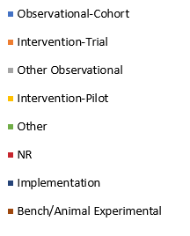
FY2021 – FY2023 Projects by Study Type
FY2021
FY2022
FY2023

Slide 8
Public Health Approach
Number of Studies by Public Health Approach FY2021
Public Health Approach | n | %
Selective | 69 | 55%
Universal | 29 | 23%
Indicated | 28 | 22%
Total | 126
Number of Studies by Public Health Approach FY2022
Public Health Approach | n | %
Selective | 59 | 47%
Indicated | 34 | 27%
Universal | 30 | 24%
NR | 3 | 2%
Total | 126
Number of Studies by Public Health Approach FY2023
Public Health Approach | n | %
Selective | 69 | 45%
Indicated | 44 | 29%
Universal | 25 | 16%
NR | 14 | 9%
Total | 152
Notes:
More indicated projects
Less universal projects
Strategies that focus on subsets of the total population, typically at-risk groups that have a greater probability of suicide behaviors.

Slide 9
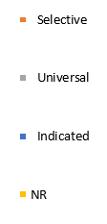
Public Health Approach
FY2021
FY2022
FY2023
Notes:
Increases in indicated approach
Decreases in selective approach

Slide 10
Socio-Ecological Model
Number of Studies by Socio-Ecological Level FY2021
Community/Society | n | %
Individual | 96 | 78%
Community/Society | 22 | 18%
Relationship | 5 | 4%
Grand Total | 123
Number of Studies by Socio-Ecological Level FY2022
Community/Society | n | %
Individual | 92 | 73%
Community/Society | 20 | 16%
Relationship | 10 | 8%
NR | 4 | 3%
Total | 126
Number of Studies by Socio-Ecological Level FY2023
Community/Society | n | %
Individual | 110 | 72%
Community/Society | 17 | 11%
Relationship | 9 | 6%
NR | 16 | 11%
Grand Total | 152
Notes:
Bottom line is most at individual level
Some increase in relationship focused projects
(Remains very hard to code)

Slide 11
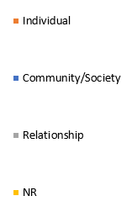
Socio-Ecological Model
FY2021
FY2022
FY2023

Slide 12
Project Key Words FY22-FY23
Key words | FY22 | FY23
Risk assessment/stratification/screening | 38 (30%) | 39 (26%)
Predictive modeling | 21 (17%) | 18 (12%)
Psychotherapy intervention | 21 (17%) | 28 (18%)
Mental health diagnosis | 20 (16%) | 28 (18%)
Qualitative methods | 20 (16%) | 24 (16%)
Social determinants of health | 19 (15%) | 19 (13%)
Biological or Behavioral risk marker | 18 (14%) | 28 (18%)
Brief interventions | 17 (13%) | 30 (20%)
Lethal means safety | 16 (13%) | 13 (9%)
Non-clinical interventions (e.g. community-level) | 12 (10%) | 8 (5%)
Crisis Intervention | 10 (8%) | 11 (7%)
Natural language processing | 9 (7%) | 8 (5%)
Safety Planning | 9 (7%) | 13 (9%)
mHealth (mobile/web application development/testing) | 8 (6%) | 10 (7%)
Peers assisting with intervention | 8 (6%) | 10 (7%)
Key words | FY22 | FY23
Pharmacological interventions | 8 (6%) | 12 (8%)
Natural language processing | 7 (6%) | 8 (5%)
Survey development | 7 (6%) | 6 (4%)
Caregivers and supports | 6 (5%) | 3 (2%)
Crisis lines (including text, chat, web, etc.) | 6 (5%) | 5 (3%)
Genomics | 6 (5%) | 5 (3%)
Healthcare disparities | 6 (5%) | 7 (5%)
Public messaging | 6 (5%) | 4 (3%)
TBI | 5 (4%) | 9 (6%)
Chronic pain and/or opioid use | 4 (3%) | 8 (5%)
Insomnia/sleep problems | 4 (3%) | 7 (5%)
Pandemics (including COVID) and suicide | 4 (3%) | 4 (3%)
Substance use and/or substance use disorders | 4 (3%) | 6 (4%)
Pharmacoepidemiology | 3 (2%) | 6 (4%)
Measure development | 2 (2%) | 4 (3%)
Non-mental health medical comorbidity | 2 (2%) | 1 (1%)
Precision (personalized) medicine | 2 (2%) | 7 (5%)

Slide 13
Project Key Words FY22-FY23
Key words | FY22 | FY23
Risk assessment/stratification/screening | 38 (30%) | 39 (26%)
Predictive modeling | 21 (17%) | 18 (12%)
Psychotherapy intervention | 21 (17%) | 28 (18%)
Mental health diagnosis | 20 (16%) | 28 (18%)
Qualitative methods | 20 (16%) | 24 (16%)
Social determinants of health | 19 (15%) | 19 (13%)
Biological or Behavioral risk marker | 18 (14%) | 28 (18%)
Brief interventions | 17 (13%) | 30 (20%)
Lethal means safety | 16 (13%) | 13 (9%)
Non-clinical interventions (e.g. community-level) | 12 (10%) | 8 (5%)
Crisis Intervention | 10 (8%) | 11 (7%)
Natural language processing | 9 (7%) | 8 (5%)
Safety Planning | 9 (7%) | 13 (9%)
mHealth (mobile/web application development/testing) | 8 (6%) | 10 (7%)
Peers assisting with intervention | 8 (6%) | 10 (7%)
Key words | FY22 | FY23
Pharmacological interventions | 8 (6%) | 12 (8%)
Natural language processing | 7 (6%) | 8 (5%)
Survey development | 7 (6%) | 6 (4%)
Caregivers and supports | 6 (5%) | 3 (2%)
Crisis lines (including text, chat, web, etc.) | 6 (5%) | 5 (3%)
Genomics | 6 (5%) | 5 (3%)
Healthcare disparities | 6 (5%) | 7 (5%)
Public messaging | 6 (5%) | 4 (3%)
TBI | 5 (4%) | 9 (6%)
Chronic pain and/or opioid use | 4 (3%) | 8 (5%)
Insomnia/sleep problems | 4 (3%) | 7 (5%)
Pandemics (including COVID) and suicide | 4 (3%) | 4 (3%)
Substance use and/or substance use disorders | 4 (3%) | 6 (4%)
Pharmacoepidemiology | 3 (2%) | 6 (4%)
Measure development | 2 (2%) | 4 (3%)
Non-mental health medical comorbidity | 2 (2%) | 1 (1%)
Precision (personalized) medicine | 2 (2%) | 7 (5%)
Notes:
Coding challenges

Slide 14
Possible next steps
Needs assessment
What do people who use these data need? Audiences include:
Operations/Program offices (Clinical and Research)
Congress
Investigators
Outside groups (e.g., DoD; NIMH)
(Eliminate socioecological model—too hard to code—not needed?)
Improved API data management system
More complete data across ORD and Operations
Standardization across ORD—single database?
Standardized information from PIs required during JIT process
Improved search functionality
What to do with NIH and other non-VA-funded research?

Slide 15
Current API (on SPRINT website)
https://www.hsrd.research.va.gov/centers/core/sprint/API_SPRINT.html

