Slide 1
Suicide Prevention: Advisory Group Monthly Meeting
March 26, 2024
Joe Constans

Slide 2
Agenda
Time | Item | Objective
3:00 – 3:05 | Review AMP Development | Discuss portfolio reorganization in ISRM Review portfolio purview statement Review priority setting process
3:05 – 3:35 | Results from Priority Survey | Review aggregate survey data from SPRINT, CMHOs, VEC Discuss themes of results
3:35 – 3:45 | Discussion Questions | SME recommendations for these domains SME questions Establish date for SP AMP Consensus Panel
3:45 – 3:50 | Next Steps | Review next steps in priority development

Slide 3
ORD Reorganization and Development of a Suicide Prevention AMP

Slide 4
Portfolio Stand-up Progress
Based on the Suicide Prevention workplan, the team plans to complete the designated documents by the end of these months.
Completed
Future Items
Role Charter
Executive Committee Charter
Program Announcements
Purview Statement
Portfolio Analysis Report
Portfolio Analysis PPT
In Progress
Critical Research Priorities
Funding Model SOP
Position Description
Portfolio Performance Metrics
November – May 2024
May - June 2024

Slide 5
Last Meeting Recall: Rapid (and Rigorous) Approach to Identifying AMP Research Priorities
AMP Priorities for RFA
Measures of Impact
Exec. Committee
Phase I: Identify research gaps and unanswered questions (e.g., SPM review, evidence inventories or reviews, VA program office strategic plans)
Phase II: Refine Priorities using concurrent processes: national surveys/live voting & focus groups with Consumer, Provider, Leader, Investigator groups
Phase III: Delphi consensus panel with interested party representatives rank priorities on urgency, impact, feasibility, identify impact metrics
Survey and focus group input inform Delphi consensus panel discussion with representatives from different groups
Existing reviews inform focus group, survey questions
Current Phase
General principles:
Priorities should reflect the research translation spectrum (e.g., T1-T4)
In-depth feedback from focus groups to identify topics not previously listed
Broad representation across interested parties via surveys, voting on top priorities
Perspectives from the front line
References:
Aligning quality improvement efforts and policy goals in a national integrated health system - Braganza - 2022 - Health Services Research - Wiley Online Library;
Health System Research Priorities for Children and Youth With Special Health Care Needs - PubMed (nih.gov),
Research Lifecycle to Increase the Substantial Real-world Im... : Medical Care (lww.com)

Slide 6
Phases to determine Critical Research Priorities
Reviewing existing literature around suicide prevention research priorities
Refining the collected priority list by conducting surveys and discussing priority topics with focus groups. Ranking of topics using structured survey.
Holding a consensus panel with the portfolio’s executive committee to review priorities and rank based on urgency, impact, and feasibility
Braganza, M. Z., Pearson, E., Avila, C. J., Zlowe, D., Øvretveit, J., & Kilbourne, A. M. (2022). Aligning quality improvement efforts and policy goals in a national integrated health system. Health Services Research, 57, 9-19.

Slide 7
Suicide Prevention Discussion Groups:
Qualitative Data

Slide 8
Phase 2: Gathering input from various stakeholders
Priority Questionnaire Distribution to Field (November 17, 2023)
A survey was sent out to investigators within the SPRINT database. We collected responses from 54 respondents, each listing ranked research priorities. These priorities were coded into the categories developed in Phase 1.
Veteran’s Engagement Council Discussion (December 7, 2023)
Our team met with a Veteran’s Engagement Council in December to hold a discussion and gather research topics of interest to veterans.
VISN Suicide Prevention Lead – Open Discussion (January 11, 2024)
Understanding Research Priorities from the perspective of VISN Leads for Suicide Prevention Coordinators.
Discussion with VA Investigators (January 19, 2024)
Discussion of qualitative data obtained and solicitations of recommendations for quantitative survey.
Discussion with CMHO (March 25, 2024)
Discussion of survey data, differences in between respondent groups.

Slide 9
Phase 2: Veteran’s Engagement Council Discussion
Key Questions for Audience:
What suicide prevention research topics come to mind as most important for Veterans from your perspective?
Are there specific patient populations it would be important to study (if this has not come up)?
Are there any research topics you don’t think are as high a priority?
Are there particular topics within this area that come to mind that would be important for VA researchers to work on?
Research Priorities Discussed during Meeting
Hard to Reach Veterans (Isolating Veterans/ Veterans not in VA care/ Rural Veterans / Transitioning to civilian)
Continuity of Care*
Community Research (including family)
Developing Novel Treatments (including provider perspective)
Moral Injury/Spiritual
Lethal Means Safety
Messaging
Peer Support
Messaging
Data Studies
Racial/Ethnic/Sexual Minorities
Brain/TBI/Genomics
* - category not identified through investigator survey

Slide 10
Phase 2: VISN Suicide Prevention Lead – Open Discussion
Key Questions for Audience:
What areas in suicide prevention do you think needs more research to support your clinical decision-making?
How does your program implement current research evidence or data regarding assessing suicide risk? What would make risk assessment processes or resulting risk information more useful or actionable?
How do you use the information you have now regarding effectiveness of suicide prevention interventions and treatments? What new information would help your program make evidence-informed treatment planning decisions?
Are there certain patient characteristics that are important to study or to include in VA research?
Research Priorities Discussed during Meeting
Risk Identification Process*
Needs modification
Clinician burden too high
Clinical Trial Feasibility*
Psychotherapy
Small trials will not advance practice
Community Interventions
Education, Training, and Messaging
Firearms, Lethal Means Safety
Safety Planning
Older Veterans
Female Veterans
* - priority areas

Slide 11
Phase 2: CMHO – Open Discussion
Key Questions for Audience:
Reviewed priority setting process and results of survey.
Solicited feedback on topic areas.
Research Priorities Discussed during Meeting
Risk Identification Process*
Need to rethink static, universal screening
Critical review of Risk ID processes
Development of dynamic risk identification processes
No significant feedback on other
* - priority areas (limited discussion)

Slide 12
Phase 2: SPRINT Investigators – Open Discussion
Key Questions for Audience:
Suggestions regarding weighting of quantitative and qualitative data to identify content domains for consideration?
Thoughts on ranking or rating of content domains in the survey? That is, what do you see as the benefits of ranking over rating and visa versa?
How many domains should be considered on the survey?
What are the recommendations regarding specificity in the domains in survey?
Research Priorities Discussed during Meeting
Survey Content
Use of count data
Include themes important to non-investigator stakeholders
Recommended different instructions
Framing language to define what is meant by “important”
Broad Categories
Rate categories
Rank top 3 categories
Specify what should be studied in top 3 categories
Populations
Rank each population

Slide 13
Suicide Prevention Survey Results

Slide 14
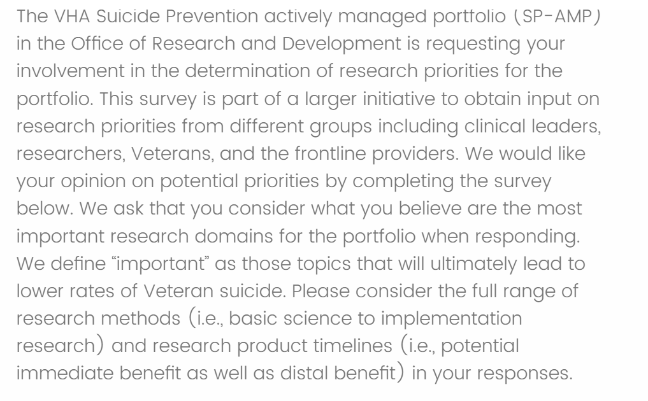
Survey
Preview

Slide 15
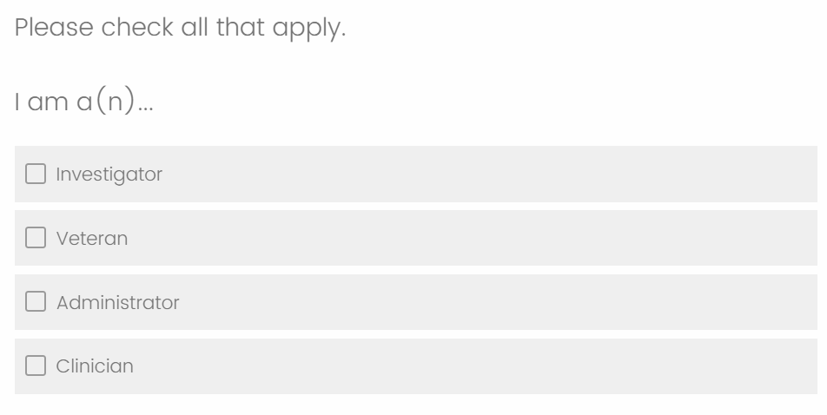
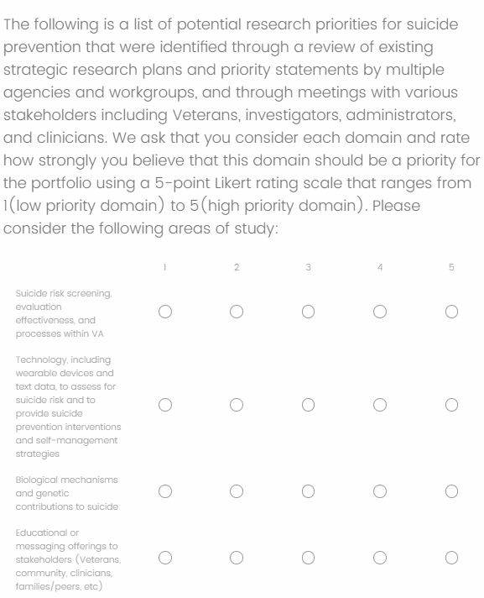
Survey - Preview

Slide 16
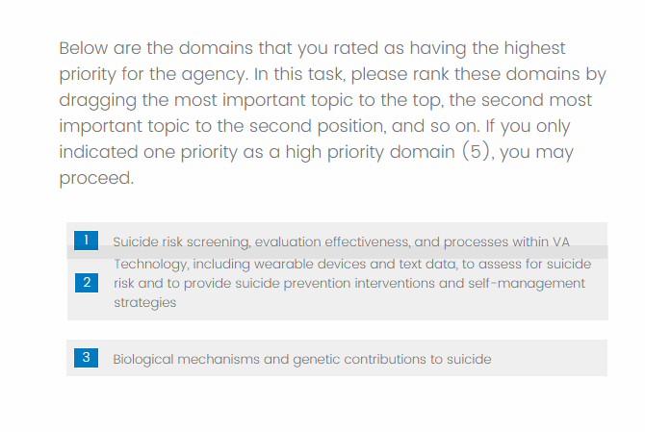
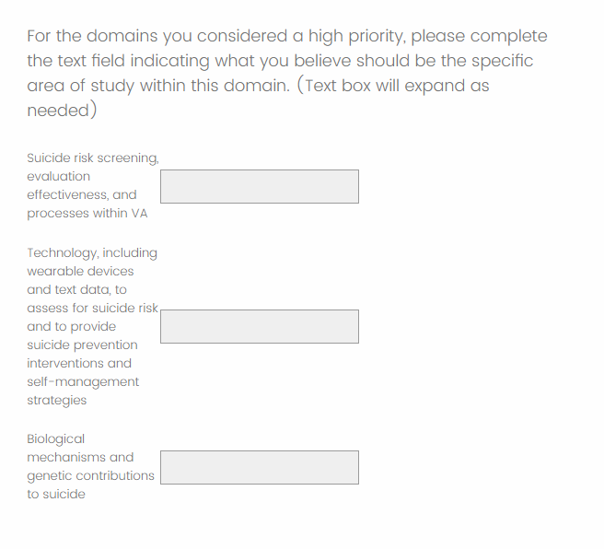
Survey - Preview

Slide 17
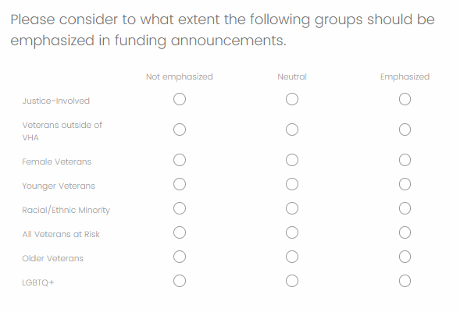
Survey - Preview

Slide 18
Suicide Prevention Priority Survey
Distribution Group | Survey Response Timeline | Responses
SPRINT Investigators | 2/14 – 2/23 | 72
VEC Veterans | 2/21 – 3/04 | 11
CMHOs | 2/28 - 3/13 | 15
Who responded*?
 | CMHO (15 responses) | VEC (11 responses) | SPRINT (72 responses) | Total (98 responses)
Administrator | 73% | 18% | 10% | 20%
Investigator | 47% | 9% | 92% | 76%
Clinician | 7% | 0% | 36% | 28%
Veteran | 0% | 82% | 1% | 10%
*Respondents could select multiple roles, the columns below will exceed 100%

Slide 19
Research Priority Domain Rating
The weighted results take into account the number of responders in each survey group
Domains | VEC Rating (11) | SPRINT Rating (68) | CMHO Rating (15) | Average Rating - Unweighted | Average Rating - Weighted
Lethal Means Safety approaches to suicide prevention | 3.91 | 4.3 | 4.15 | 4.12 | 4.23
Community-based interventions for suicide prevention | 4.36 | 4.24 | 3.46 | 4.02 | 4.13
Psychotherapies and other non-somatic interventions for suicide prevention | 3.36 | 4.18 | 3.69 | 3.74 | 4.01
Family and social network-based interventions and postventions | 4.09 | 4.07 | 3.69 | 3.95 | 4.01
Suicide risk screening, evaluation effectiveness, and processes within VA | 3.45 | 3.79 | 4.62 | 3.95 | 3.88
Technology, including wearable devices and text data, to assess for suicide risk and to provide suicide prevention interventions and self-management strategies | 3.55 | 3.51 | 3.38 | 3.48 | 3.49
Educational or messaging offerings to stakeholders (Veterans, community, clinicians, families/peers, etc) | 3.73 | 3.38 | 2.62 | 3.24 | 3.3
Machine-based suicide risk algorithms that utilize large existing data sets to improve risk accuracy or developing precision-medicine approaches to suicide prevention | 2.73 | 3.31 | 3.62 | 3.22 | 3.29
Psychopharmacological and other somatic interventions (e.g., TMS) to prevent suicide | 2.36 | 3.19 | 3.62 | 3.06 | 3.16
Biological mechanisms and genetic contributions to suicide | 2.91 | 2.76 | 3.54 | 3.07 | 2.9

Slide 20
High Priority Domain Example Studies
Domains | Selected Free Responses
Lethal Means Safety approaches to suicide prevention | Focus resources on rapidly implementing and assessing the impact of current best practice lethal means safety for suicide prevention. Examining the impact of Lethal Means Safety Counseling Interventions on Behavior (e.g., use of safe storage); examining the impact of LMS programs and distribution of safe storage on suicidal behaviors and death
Suicide risk screening, evaluation effectiveness, and processes within VA | Identification of veterans at low to moderate risk who should be targeted through public health approaches, particularly those outside of mental health evaluation of effectiveness of traditional screening within VA. Does filling out a CSSRS impact clinical outcomes
Family and social network-based interventions and postventions | Interventions to improve support and helpfulness of family members and professional caregivers in their efforts to support a Veteran at risk for suicide
Psychotherapies and other non-somatic interventions for suicide prevention | We need more work aimed at figuring out the most cost effective approaches for reducing suicide risk through therapy. It's not clear how much CBT-SP does over and above safety planning alone; group format's need to be explored as well as web-based and digital interventions. We need to try to get the interventions that are known to work to as many at risk veterans as possible. Developing novel psychotherapies to address suicide risk and conducting randomized controlled trials to build their evidence base Developing a large network of sites for large multi-site clinical trials.
Community-based interventions for suicide prevention | I agree with those who note that VA work must be paired with community interventions to help those who will never enter a VA (the majority of suicides). We know very little in this area. Developing strategies to engage non-VHA users in SP programming at VA including LMS counseling. building collaborations with community partners and leveraging community resources to create shifts/changes in suicide outcomes over the longer term

Slide 21
Key Priority Areas
Based on the analysis of the survey results, these 5 areas were deemed to be the key priority areas. Suicide Prevention Portfolio will focus on addressing one or more of these priorities in the coming fiscal years.
Lethal Means Safety approaches to suicide prevention
Community-based interventions for suicide prevention
Family and social network-based interventions and postventions
Psychotherapies and other non-somatic interventions for suicide prevention
Suicide risk screening, evaluation effectiveness, and processes within VA; predictive analytics
The next step in the Critical Research Priority setting process encourages us to determine what are the specific gaps in research within these domains that we can plan to address.

Slide 22
Next Steps

Slide 23
SME Suggestions
Lethal Means Safety | Community-Facing SP Research | Psychotherapies Research | Family and social network-based interventions and postventions | Suicide risk screening, evaluation effectiveness, and processes within VA; predictive analytics*
Ian Stanley (VA WOC) | Bryann DeBeer (VA) | Peter Britton (VA) | Marianne Goodman (VA) | Nasi Bahraini (VA)
Emmy Betz (non-VA) | Monica Matthieu (VA) | Craig Bryan (VA) | BryAnn Debeer (VA) | Steve Dobscha (VA)
Joe Simonetti (VA) | Gala True (VA) | Greg Brown (non-VA) | Alan Teo (VA) | Ron Kessler (non-VA)
Mike Anestis (non-VA) | Peter Wyman (non-VA) | David Rudd (non-VA) | Jason Chen (VA—early career but has done work on social networks and post vention; also disparities) | Rob Bossarte (VA)
Steve Dobscha (VA) | Marianne Goodman (VA) | Ken Connor (high risk and SUD; non-VA) |  | Bridget Matarazzo (VA)
Cathy Barber (non-VA) | Ray Tucker (non-VA) | Kim Van Orden (older adults; non-VA) |  | Greg Simon (non-VA)
Matthew Miller (non-VA) |  | Kate Comtois (non-VA) |  | Lisa Brenner (VA)
 |  | Sean Barnes (VA) |  | Nate Kimbrell (VA)
 |  | Mark Ilgen (VA)
 |  | Alex Interian (VA)
 |  | David Rozek (non-VA)
Plan:
Select 5 (3 VA / 2 non –VA); move down list if no response
*Additional recommendations submitted by Drs. Strickland and Villareal

Slide 24
SME Questions
Based on your knowledge of the state of the science, can you identify 1 to 3 research questions that would be especially important to answer and/or key next steps within the overall topic domain of XYZ?
What type of research strategies would best help to answer these research questions? For example, do you believe that advancement would be best realized through clinical trial research, implementation science investigations, development of novel interventions, or improve understanding of the mechanisms through which this topic area is associated with suicide?
In considering your response above, do you believe that organizations should prioritize funding smaller numbers of large trials to improve confidence in existing findings or more numerous smaller investigations that may lead to improved or novel strategies?
What type of professional expertise is required for the study teams to pursue the research that you are recommending?
Anything else?

Slide 25
Consensus Panel Discussion
Collection and Analysis of SME Responses
Presentation of results in April to Advisory Group
Looking to determine a date for voting…
Tuesday May 21st ???????
Department of Veterans Affairs – Office of Research & Development |  | Constituency
Wendy Tenhula | Deputy Chief Research and Development Officer (CRADO), ORD, Dept. of Veterans Affairs | Voting Member
David Atkins | Former Director, HSR&D, Dept. of Veterans Affairs, VA WOC employee | Voting Member
Kara Beck | QUERI Representative, ORD, Dept. of Veterans Affairs | Voting Member
VHA Stakeholders |  | Constituency
Jodi Trafton | Director, VA Program Evaluation and Resource Center | Member
Bradley Watts | Research Director, VHA Office of Rural Health | Member
Department of Veterans Affairs – Office of Mental Health and Suicide Prevention |  | Constituency
Matt Miller | Director, Suicide Prevention, Office of Mental Health and Suicide Prevention | Voting Member
Susan Strickland | Director of Research Coordination, Office of Mental Health and Suicide Prevention | Voting Member
Edgar Villareal | National Clinical Director, Office of Mental Health and Suicide Prevention | Voting Member
External Federal Funding Agency
Stephen O’Connor | NIH Representative | Voting Member
Melissa Mehalick | DoD Representative | Voting Member

Slide 26
Discussion

Slide 27
Appendix

Slide 28
High Priority Domain Ranking
Domains | VEC Ranking (incomplete)* | SPRINT Ranking | CMHO Ranking | Aggregate Ranking | Aggregate No. 1 Rankings
Lethal Means Safety approaches to suicide prevention | 20 | 342 | 29 | 391 | 12
Community-based interventions for suicide prevention | 18 | 467 | 19 | 504 | 6
Psychotherapies and other non-somatic interventions for suicide prevention | 7 | 350 | 35 | 392 | 14
Family and social network-based interventions and postventions |  | 374 | 0 | 374 | 4
Suicide risk screening, evaluation effectiveness, and processes within VA |  | 138 | 31 | 169 | 2
Technology, including wearable devices and text data, to assess for suicide risk and to provide suicide prevention interventions and self-management strategies |  | 209 | 15 | 224 | 0
Educational or messaging offerings to stakeholders (Veterans, community, clinicians, families/peers, etc) | 9 | 57 | 0 | 66 | 1
Machine-based suicide risk algorithms that utilize large existing data sets to improve risk accuracy or developing precision-medicine approaches to suicide prevention | 9 | 145 | 19 | 173 | 3
Psychopharmacological and other somatic interventions (e.g., TMS) to prevent suicide |  | 200 | 17 | 217 | 1
Biological mechanisms and genetic contributions to suicide |  | 72 | 17 | 89 | 3
Weighted Methods:
- A Ranking of 1 gives the domain a score of 10, down to a Ranking of 10 gives the domain a score of 1. Combining all rankings across all responses results in these overall ranks.
Recommend collapsing this domain into suicide risk screen based on feedback from SPC Leads and CMHO

