Slide 1
VA Suicide Prevention Research Advisory Council
Joseph Constans
March 28, 2023

Slide 2
How ISRM is transitioning from Services-Based Research to Portfolio-Based Research
The Four Services of Research Disciplines
Actively Managed Portfolios & Broad Portfolios
Clinical Science
R & D
D
Clinical Science
R & D
D
Clinical Science
R & D
D
Clinical Science
R & D
D
Clinical Science
R & D
D
Clinical Science
R & D
D
Clinical Science
R & D
D
Clinical Science
R & D
Rehab
R & D
Precision Oncology AMP
11/1/22
Pain/ Opioid Use
AMP
1/31/23
3rd AMP
TBD
Health System Services
Broad Portfolio
1/31/23
2nd
Broad Portfolio
TBD
Clinical Science
R & D
D
Clinical Science
R & D
D
Health Services
R & D
Bio-medical Lab
R & D
Each Portfolio will be developed in a way to encourage cross-collaboration throughout the Field
2
Notes:
Chris To Present
Talking Points
The main purpose of this slide is to emphasize the transition of ISRM from a Service-based research organization to a Portfolio-based research organization
A major part of ORD’s enterprise transformation is the transition of funding research through the Services to funding research through portfolios
Over the course of FY23, the ISRM Organization initiative will pilot different models of portfolios in order to determine which models work best for ISRM
Our goal is then to transition from funding research through the 4 Services to funding research through Actively Managed Portfolios and Broad Portfolios
These portfolios will prioritize collaboration and cross-cutting partnerships with researchers, clinicians, and other VA stakeholders
We launched Precision Oncology as the first prototype Actively Managed Portfolio during FY22 and are working to stand up a second AMP focused on treating Veteran pain and a Broad Portfolio focused on health systems research.
In the next slide, we’ll cover what makes each of these prototype portfolios unique

Slide 3
ISRM Organization Initiative: Testing New Portfolio Designs
ISRM will pilot-test different leadership models, funding models, and review processes through AMPs and Broad Portfolios
Clinical Science
R & D
D
Clinical Science
R & D
D
Clinical Science
R & D
D
Precision Oncology AMP
Single SPM Model
Defined Budget
Accelerated Review + Standard Merit Review
Pain / Opioid Use AMP
Rotational model of 4 SPMs
Competitive Budget
Standard Merit Review
Health Systems Broad Portfolio
Director-led model
Defined Budget
Standard Merit Review
Leadership Model
Funding Model
Review Process
Notes:
Chris to Present
Talking Points
The main purpose of this slide is to highlight the 3 test portfolios and what makes each of them different.
Precision Oncology AMP utilizes:
A single SPM leadership model, led by Dr. Ken Myrie
A defined budget that can only be spent on precision oncology
The new accelerated review process for priority research
Pain/Opioid Use AMP will utilize:
A rotational leadership model amongst 4 SPMs from each of the Services. This leadership model is designed to increase collaboration across the Services and reduce duplicative research
A competitive budget
Standard Merit Review processes
Health Systems Research Broad Portfolio will utilize
A director-led leadership model, headed by Dr. David Atkins
A defined budget for HSR projects
Standard Merit Review processes
Over fiscal year 23, ISRM will implement, measure, and evaluate these different portfolio models to help inform the overall portfolio design of ISRM

Slide 4
ORD Leadership
Wendy Tenhula,
David Atkins, HSRD
Other agencies
Steven O’Connor, NIH
Melissa Mehalick, DoD
ORD Managers
Joseph Constans, SP
Bob O’Brien, HSRD
Vetisha McClair, CSRD
Peter Hunt, RRD
Admin Support
Imani Braxton-Allen
OMHSP
Matt Miller, Director SP
Susan Strickland, SP
OMHSP Center Leads
Lisa Brenner, RM MIRECC
Stephanie Gamble, CoE
ORD Center Leads
Steve Dobscha, SPRINT
Brian Marx, SPRINT
IT/VA Data
Jodi Trafton
VA Research Advisory Committee
Members

Slide 5
Aim 1: Improve Communication & Coordination

Slide 6
Aim 1: Improve Communication & Coordination
VA ORD Suicide Prevention Investment FY16-22
Total funding for the period of FY22 was $18,698,405

Slide 7
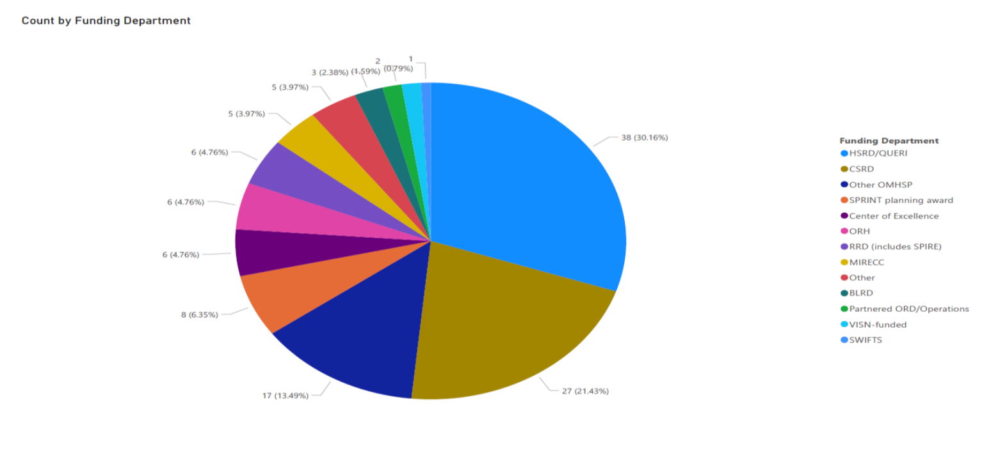
Aim 1: Improve Communication & Coordination
Data Source: VA Suicide Prevention Research Tracked by SPRINT

Slide 8
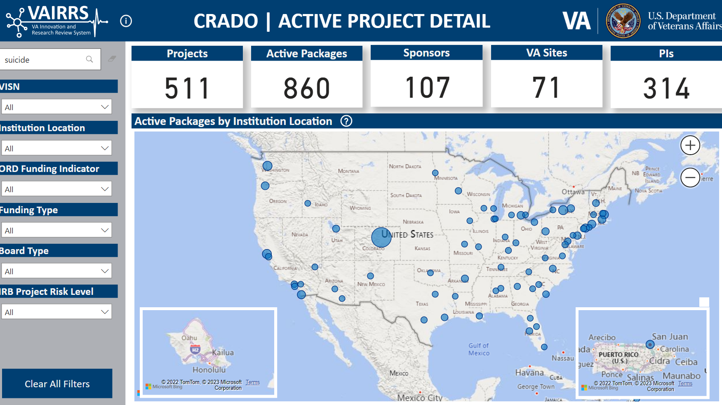
Aim 1: Improve Communication & Coordination

Slide 9
Aim 2: Determine Processes for Establishing Research Priorities and Creating Research Roadmap

Slide 10
Suicide Prevention Portfolio Analysis Report
Veterans Health Administration Office of Research and Development
October 2021
Strategic Goals – Strategic Goals for the Suicide Prevention portfolio were co-created by VA researchers and the analytic team for this analysis. Studies were analyzed to determine if they aligned to one more of these strategic goals. Limited to studies started after 2018
Alignment – Whether a study or publication contributes to or supports a strategic goal

Slide 11
Strategic Directions & Goals from VA’s National Strategy for Preventing Veteran Suicide; All studies started after 2018 were analyzed for alignment to one or more objectives
Determine Processes for Establishing Research Priorities
The VA Office of Mental Health and Suicide Prevention developed VA’s National Strategy for Preventing Veteran Suicide to highlight the importance of suicide prevention among Veterans and direct future action
The National Strategy outlines 4 Strategic Directions and 14 corresponding Goals
STRATEGIC DIRECTION 1: Healthy and Empowered Veterans, Families, and Communities | GOAL 1 — Integrate and coordinate Veteran suicide prevention activities across multiple sectors and settings. GOAL 2 — Implement research-informed communication efforts designed to prevent Veteran suicide by changing knowledge, attitudes, and behaviors. GOAL 3 — Increase knowledge of the factors that offer Veterans protection from suicidal behaviors and that promote their wellness and recovery. GOAL 4 — Promote responsible media reporting of Veteran suicide, accurate portrayals of Veteran suicide and mental illnesses in the entertainment industry, and the safety of online content related to Veteran suicide.
STRATEGIC DIRECTION 2: Clinical and Community Preventive Services | GOAL 5 — Develop, implement, and monitor effective programs that promote wellness and prevent Veteran suicide and related behaviors. GOAL 6 — Promote efforts to reduce access to lethal means of suicide among Veterans with identified suicide risk. GOAL 7 — Provide training to community and clinical service providers on the prevention of suicide and related behaviors.
STRATEGIC DIRECTION 3: Treatment and Support Services | GOAL 8 — Promote suicide prevention as a core component of health care services. GOAL 9 — Promote and implement effective clinical and professional practices for assessing and treating Veterans identified as being at risk for suicidal behaviors. GOAL 10 — Provide care and support to individuals affected by suicide deaths and suicide attempts to promote healing, and implement community strategies to help prevent further suicides.
STRATEGIC DIRECTION 4: Surveillance, Research, and Evaluation | GOAL 11 — Increase the timeliness and usefulness of national surveillance systems relevant to preventing Veteran suicide and improve the ability to collect, analyze, and use this information for action. GOAL 12 — Promote and support research on Veteran suicide prevention. GOAL 13 — Evaluate the impact and effectiveness of Veteran suicide prevention interventions and systems, and synthesize and disseminate findings to inform future efforts. GOAL 14 — Refine and expand the use of predictive analytics for at-risk Veterans and for known upstream risks such as opioid use.

Slide 12
Determine Processes for Establishing Research Priorities
.

Slide 13
Aim 2: Determine Processes for Establishing Research Priorities and Creating Research Roadmap
Agenda for Upcoming Meetings
April
Description of Suicide Prevention Research Portfolio
Pain Opiate Use Portfolio presentation
May
Development of Suicide Prevention Dashboard
Determining Purview
June
Establishing a Charter
Organizational Structure of Executive Committee
Preventing COI
July
Utilization of CORES in Portfolio management
Processes for receiving guidance/feedback from field
RFA structure
August
Metrics for Success
Recommendations to ISRM for Suicide Prevention Portfolio Management

