Slide 1
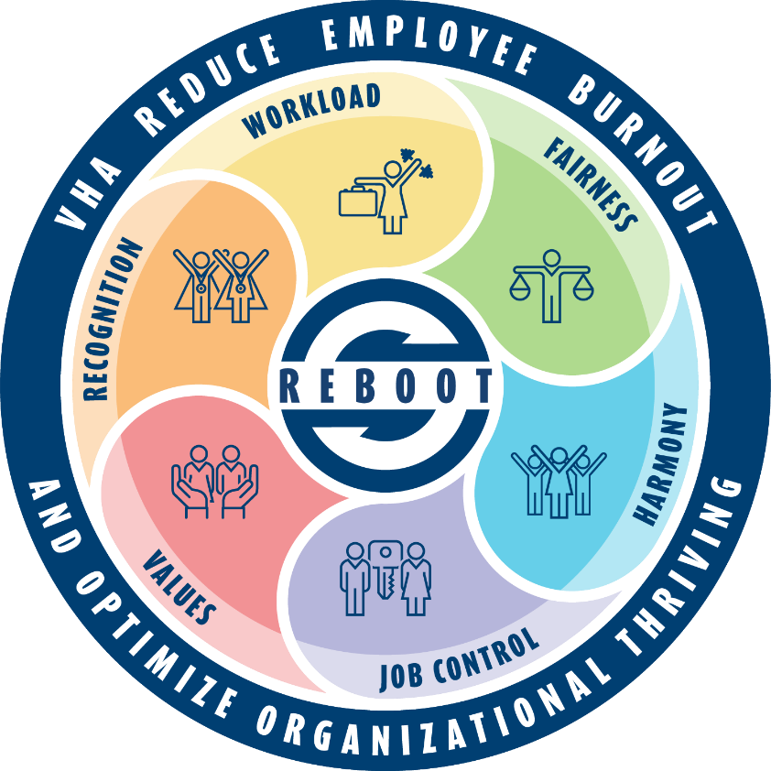
VHA Reduce Employee Burnout and Optimize Organizational Thriving (REBOOT) Initiative
Communications Plan
Presentation to National Chiefs of Staff Call
March 29, 2023
Presenters: Maureen Marks, PhD Jessica Bonjorni, MBA Lucy Houghton, PhD, RN Mark Upton, MD Keith Welsh, LCSW | Jacob Beste, BSN, RN, PHN Kristi Groves RN, BSN, MBA-HCM, CPHQ Jason Petti, MS/HAS Kavitha Reddy, MD

Slide 2
Overview
Through Reduce Employee Burnout and Optimize Organizational Thriving (REBOOT), VHA is building a workplace where every employee can thrive and find purpose, fulfillment, and joy in their work.
REBOOT is a long-term initiative to address burnout and promote wellbeing among employees.
VHA has listened to employees to gain an understanding about major factors contributing to burnout and ways to better support employee wellbeing.
To address these contributors, REBOOT is implementing sets of actions across seven (7) priority focus areas.
Notes:
Lucy and Maureen to cover
LISTENING TO EMPLOYEES
Since it was established in 2021, REBOOT has received and responded to more than 700 direct e-mail messages from VHA employees.
Employees shared their challenges, ideas, and support for REBOOT and their desire to be part of its work.
Based on feedback from employees, REBOOT prepared a set of recommended actions for implementation in VHA.
REBOOT then hosted 11 focus group sessions where employees shared feedback on potential actions. The focus groups were crucial for prioritizing actions.
The list of recommended actions was pared down to seven (7) priority focus areas in May 2022.
Focus areas were then approved by the VHA Governance Board on June 23, 2022.

Slide 3
VHA Priority Focus Areas
VHA and the REBOOT Task Force announced seven (7) priority focus areas on Tuesday, September 6, 2022 to all employees.
Focus areas represent opportunities where VHA can take meaningful action nationally to benefit the most employees.
Actions are designed to inspire, complement and build on local efforts, such as REBOOT efforts at VA Northeast Ohio (video).
VHA continues to press forward to address other challenges such the hiring process and staffing shortages.
Chief
Notes:
Jessica to cover

Slide 4
Priority Focus Areas and Actions
Optimize Meeting Practices. Encourage and incentivize the use of effective meeting practices, including the frequency and length of meetings.
Worked closely with Office of Information and Technology (OIT) and VHA Communications to prepare the launch of Operation Exhale, an initiative to shorten meetings and encourage the adoption of best practices to increase meeting effectiveness.
Go-live date: March 24, 2023
Launch included adjustment of meeting defaults settings in Microsoft Outlooks and an educational campaign enterprise wide.
VHA continues to look at broader opportunities to set, reinforce and incentivize the use of effective meeting standards practices and etiquette.
Notes:
Mark to cover

Slide 5
Priority Focus Areas and Actions
Optimize TMS Education and Training. Streamline approaches for employees to gain vital education and training, such as the use of test-out options.
Actions
VHA is piloting test-out option for completing mandatory TMS training courses in 2023. EES and the Office of Research are also launching a pilot to offer a “test out” option for some mandatory TMS training courses.
VHA will also continue the use of temporary TMS training moratoriums when appropriate as a tool to bring relief to employees while encouraging and supporting VAMC, VISN, and VHACO organizations to use TMS test-out options and moratoriums when available.
Piloting an improved and uniform data mining template to provide an accurate snapshot of required training per clinical job type across VHA. TMS Stand-Downs and data gathering in the past produced less reliable data due to variations in nomenclature across the system.
A validated template will identify excessive TMS assignments by job type and provide data-driven recommendations on training CAPS.
Notes:
Keith and Jacob to cover

Slide 6
Priority Focus Areas and Actions
Address Inefficiencies. Empower and reward leaders and teams at all levels to identify and eliminate inefficiencies to enhance the work environment for all staff.
Actions as of March 7, 2023
Met with Deputy Network Directors to discuss the quality framework, High Reliability Organization (HRO) and the year of Continuous Process Improvement (CPI)
Standardized performance element within SES Program Office Performance Plan completed
Aligned efforts with Year of CPI and HRO efforts
Communication campaign to VHA, VISN and Medical Center leadership
Leveraging National Organization for Leadership and Analytics University (NOLA U) for learning/knowledge/skill building around:
Improvement tool kits
Improvement project identification matrix
Use of the voice of customers to inform opportunities
Notes:
Kristine Groves and Jason to cover

Slide 7
Priority Focus Areas and Actions
Implement Chief Wellbeing Officer (CWO). Establish the CWO role to engage, advocate for, and foster wellbeing among clinical staff.
Actions as of March 22, 2023
VHA Governance Board approved 18 CWOs to be hired in FY23 (1 per VISN at the facility level); 10 early adopter sites identified
Of the 18 selected EDM sites: 33% hired, 56% actively recruiting, 11% HR processing.
3 CWO Fundamentals Conference during FY23 (0ctober 2022-Complete, April 2023-Nashville, TN, August 2023-San Diego, CA)
Partnered with LEARN for multi-year evalution-FY23 focused EDM facilities’ organizational readiness to implement the CWO role via 45 minutes semi-structured interviews with one executive sponsor at each of the 18 EDM sites.
The CWO Program is recommending and providing training, guidance, and support around the utilization of Listen, Sort, Empower as a method for CWOs to work with clinical teams to help address inefficiencies.
The national CWO Program Team will provide education, community-building and evaluation support for CWOs. For information, contact VHACWOprogram@va.gov.
Notes:
Kavitha to cover

Slide 8
Provider Workload Burden Integrated Project Team Co-Lead by Dr. Ami Shah and Randy Snider
Developed and presented CPRS alerts reduction strategies through a streamlined process for patients who cancel or delay their imaging exams.
Constructed an educational SharePoint site with best practices in CPRS Alerts reduction targeted to PCP’s, with dedicated Town Hall meetings.
Released an innovative tool for HIS/CACs to build their own CPRS objects to streamline referral processes and documentation.
CPRS Booster approved for installation and use across VA after years of roadblocks and variance in rules interpretation.
Promoted and lobbied extensively for the Brillians acquisition. It is now in use across approximately 30% of VA.
Issued PACT Team staffing guidelines in publication form including a patient-centered team guide showing roles and responsibilities within the staffing model.
Developed and released a tool to improve processes and patient care by eliminating the need for consults for patients seen in a specialty within 3 years.
Initiated the AMIA 25x5 model to reduce provider documentation to 25% of current state within five years.
Built a dedicated, educational SharePoint site, Provider Workload Burden IPT Information - Home (sharepoint.com) , with all efforts related to the Provider Workload Burden IPT.
Notes:
Kavitha to cover

Slide 9
Priority Focus Areas and Actions
Maximize Use of HR Policies/Flexibilities. Communicate, encourage use of available HR policies and flexibilities to boost employee wellbeing, retention and recruitment efforts.
Actions as of March 7, 2023
Expanding schedule flexibilities
72/80 Proposal to Governance Board for full implementation of 72/80 schedule for Registered Nurses (RNs) in bedded units – target date 4/30/2023
Development of a 72/80 Blueprint for how to implement the 72/80 effectively (90% complete) and training slide deck (50% complete) – target date 4/30/2023
Development of a broader Schedule Flexibility Blueprint that describes all the schedule flexibilities available and how to implement them including instructions for coding (50% complete) – target date 5/31/2023
Develop standardized business rules for automatic backfill of positions – consistent with newly-developed Tiger Team goals
Reviewing processes at facilities that have automatic backfills in place
Reviewing data sources for development of business rules
Propose standardized business rules – target date 4/1/2023

Slide 10
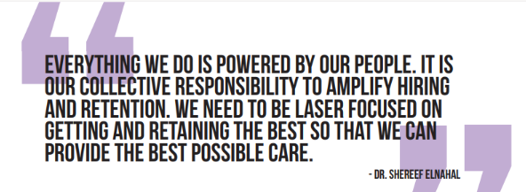
Priority Focus Areas and Actions
Maximize Use of HR Policies/Flexibilities. Communicate, encourage use of available HR policies and flexibilities to boost employee wellbeing, retention and recruitment efforts.
Actions as of March 7, 2023
Broader implementation of Hire Right Hire Fast (HRHF) – consistent with newly developed Tiger Team goals
Ensure facilities are fully using HRHF for at least 3 of the 4 occupations that have national communities of practice, i.e., 3566 HKA (Housekeeping Aid/Environmental Services Tech), 7408 FSW (Food Service Worker), 0679 MSA (Medical Support Assistant), and 0610 RN (Registered Nurse) – target date 9/30/2023
Expand HRHF to 0620 LPN (Practical Nurse) and 0621 NA (Nursing Assistant) – target date 6/30/2023
Revise and enhance HRHF toolkit/share point and develop tracking mechanism for implementation – target date 6/30/2023

Slide 11
Priority Focus Areas and Actions
Strengthen Mental Health Support. Increase investments in mental health resources, ensuring employees know what resources are available and how to ask for support.
Actions
Scaling Peer Support
Working on proposal to scale employee peer support program with plans to pilot VISN level implementation model utilizing clinicians within the Clinical Resource Hubs (CRHs); interested clinicians will be trained as peer support volunteers to provide assistance to employees across the VISN during stressful times and after critical incidents.
EAP Modernization
Working on proposal for EAP modernization at VA medical centers and VHACO that will include recommending a hybrid model of service delivery.
Currently in the process of surveying in-house EAP coordinators to better understand current state of EAP and identify gaps in clinical oversight, training and service provision within VHA.

Slide 12
Priority Focus Areas and Actions
Strengthen Mental Health Support. Increase investments in mental health resources, ensuring employees know what resources are available and how to ask for support.
Actions continued…
Additional Options for Acute Crisis Support
Identified existing VA standard procedure for responding to a non-veteran employee experiencing acute SI/HI. Discussing the recommendation for further communication of this procedure.
Identified other existing employee acute crisis support programs and discussing how to scale these programs across facilities.
Each of the three workgroups will present options to the REBOOT implementation team and eventually the Employee Engagement Committee/Organizational Health Council for approval. We plan to seek feedback from network directors as well on proposed tactics to strengthen mental health support for employees.

Slide 13
Priority Focus Areas and Actions
Strengthen Culture of Servant Leadership. Increase the practice of servant leadership principles at all levels of the VHA organization.
Actions as of March 7, 2023
VHA will expand efforts already underway, including servant leader education and training within HLTI leadership programs, promotion of Servant Leadership Gaming Module, Supervisor Coordinator positions currently being piloted at 10 VAMCs.
VHA will also increase awareness of servant leadership learning opportunities and expand opportunities and ways to incentivize, reward and recognize employees demonstrating servant leadership behaviors.
Potential tools for implementation
Servant Leader 101 Training Module
NCOD leadership possible additions: Tips for dealing with backlash, Stay In VA interview/discussion principles
Experiential learning activities rather than slide decks Possibly a follow-on to initial “training” to address challenges long term
Leverage existing management tools (e.g., DiSC, Strengthsfinder) outside of NCOD consultations to increase motivation and desire to do something differently

Slide 14
Next Steps
REBOOT is now an implementation team aligned within the VHA Organizational Health Council (OHC).
OHC reports to the VHA Governance Board.
Seven workstreams are implementing actions within each priority focus area.
The REBOOT implementation team and workstreams have both VHACO and field representation.
Expect continued, periodic updates from the USH on REBOOT implementation progress.
Notes:
Jessica to cover and Mark to provide closing remarks

Slide 15
Resources
VHA REBOOT Initiative
REBOOT Webpage (VA Insider)
Supporting Resources
Scheduling Flexibilities FAQS
Telework for Primary Care Employees Memo
Employee Whole Health
Send gratitude to a colleague through the #VAGratitude app.
USH Updates on REBOOT
REBOOT Implementation Status Update (December 2022)
Announcing REBOOT priority focus areas (Sep. 2022)
Preparing for REBOOT implementation (Jun. 2022)
Staffing challenges and contribution to burnout (May 2022)
Focus groups, supporting employee Whole Health (Apr. 2022)
Possible recommended actions, focus groups (Mar. 2022)
Flexible schedules, TMS training moratorium (Feb. 2022)
Talking with staff about scheduling flexibilities (Feb. 2022)
Simplifying your work environment (Dec. 2021)
Video intro to REBOOT from Dr. Marcia Lysaght (Nov. 2021)
Addressing employee burnout: REBOOT task force (Nov. 2021)

Slide 16
Discussion and Questions

